Slide 1
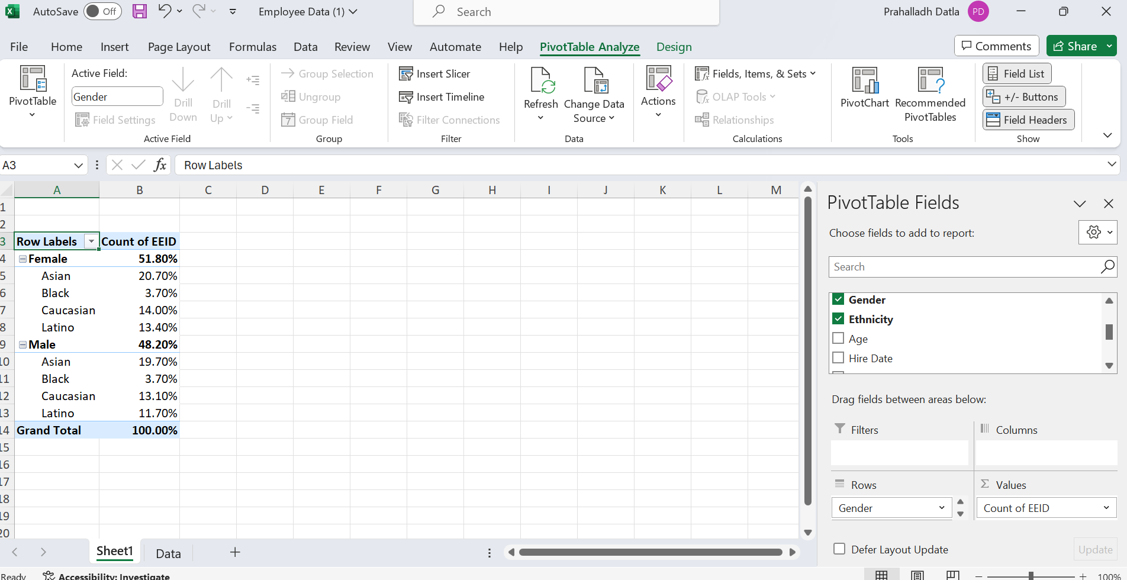
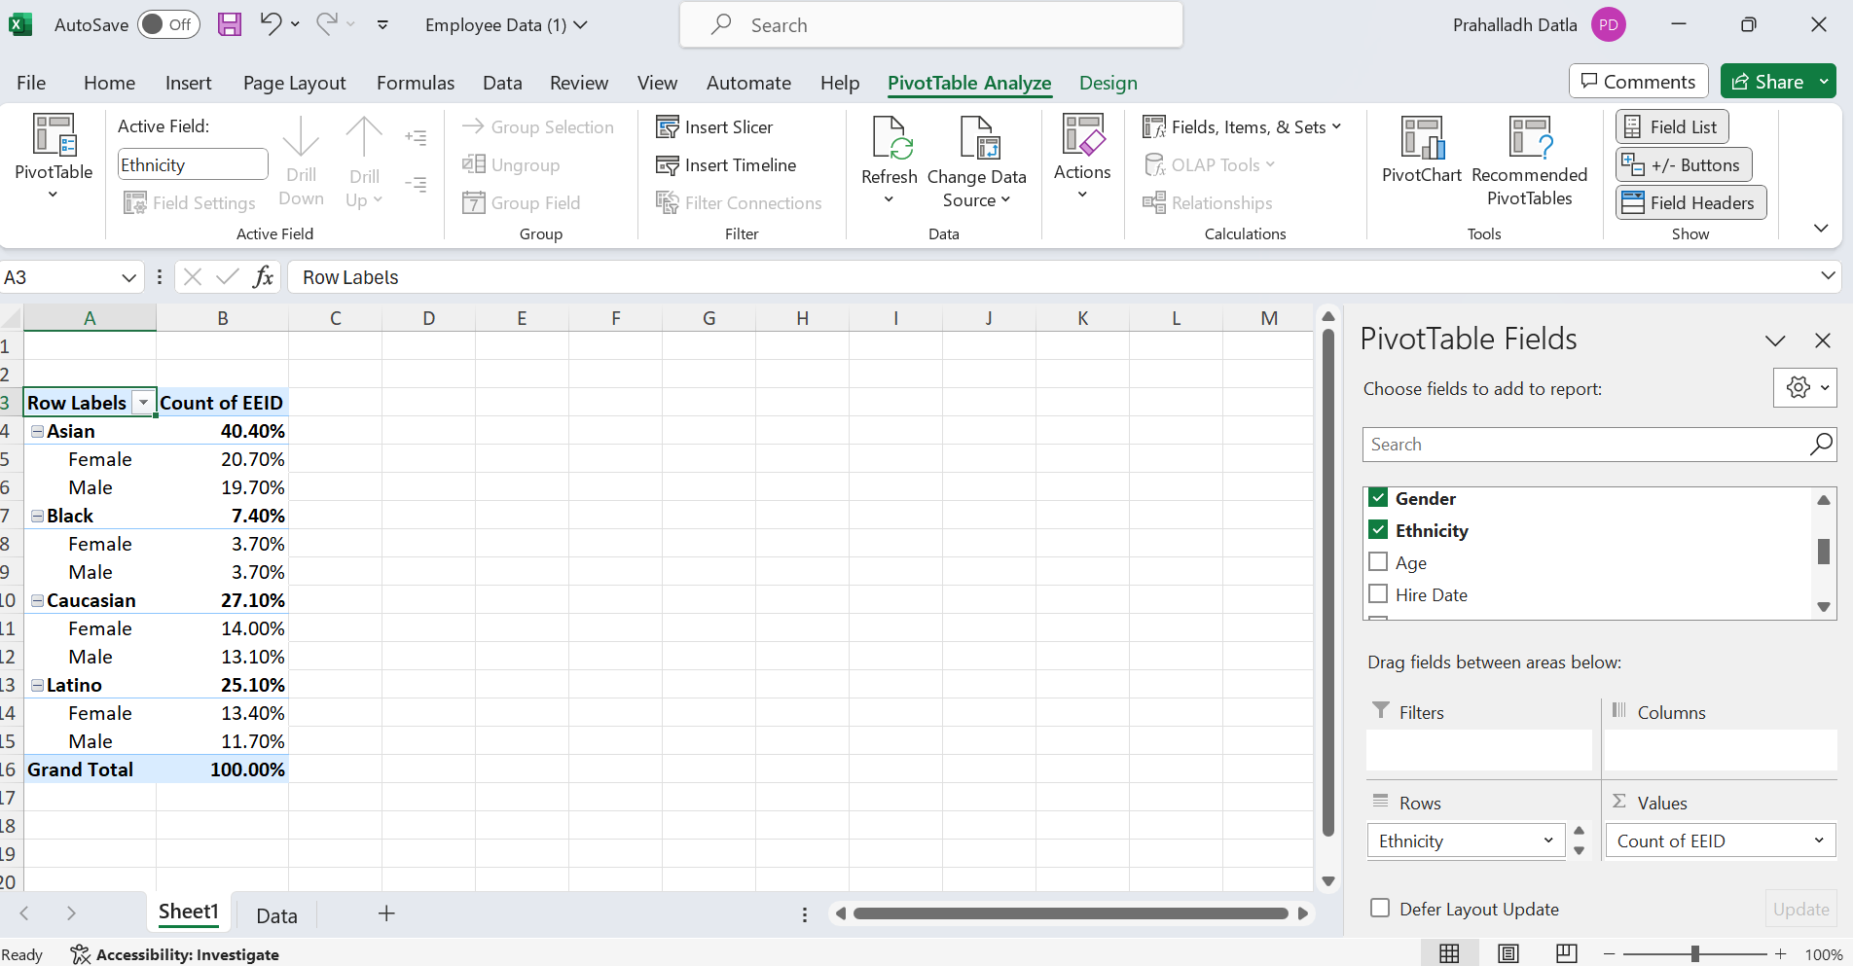
Q1.GENDER AND ETHINICITY
Out of all the employees, Asians are the largest community compromising 40% followed by Caucasian with 27.10%.
Coming to gender Out of all the employees, Females are 51.80% and Males are 48.20%. In females again 20.70% are of Asian and In males 19.70% are of Asia.
origin
Used Pivot Table to perform

Slide 2
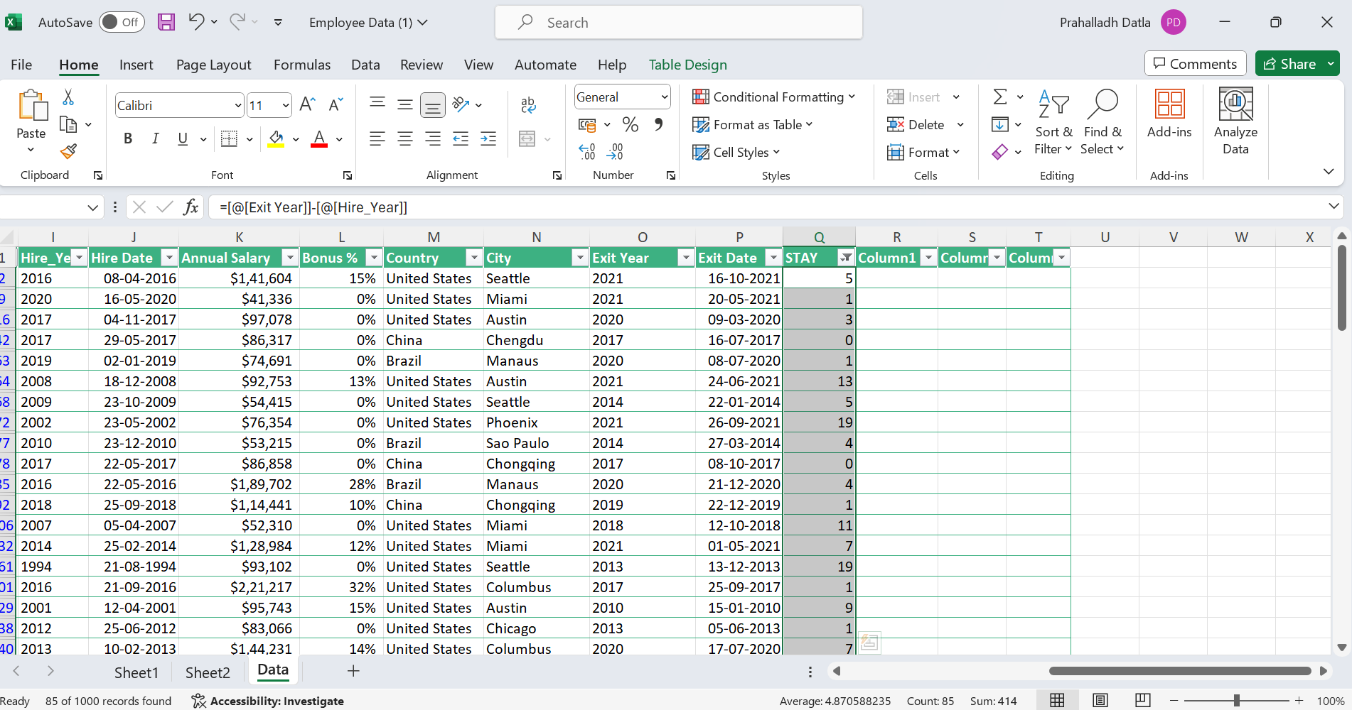
Q2.AVG STAY
On Average people stayed 4.8 years before leaving the company. I first created two columns from Hire date and exit Date having Only the year using TEXT function and then the diff of them in a separate new column. This way I got all the employes stay and then AVG which is approx. 4.8 Years

Slide 3
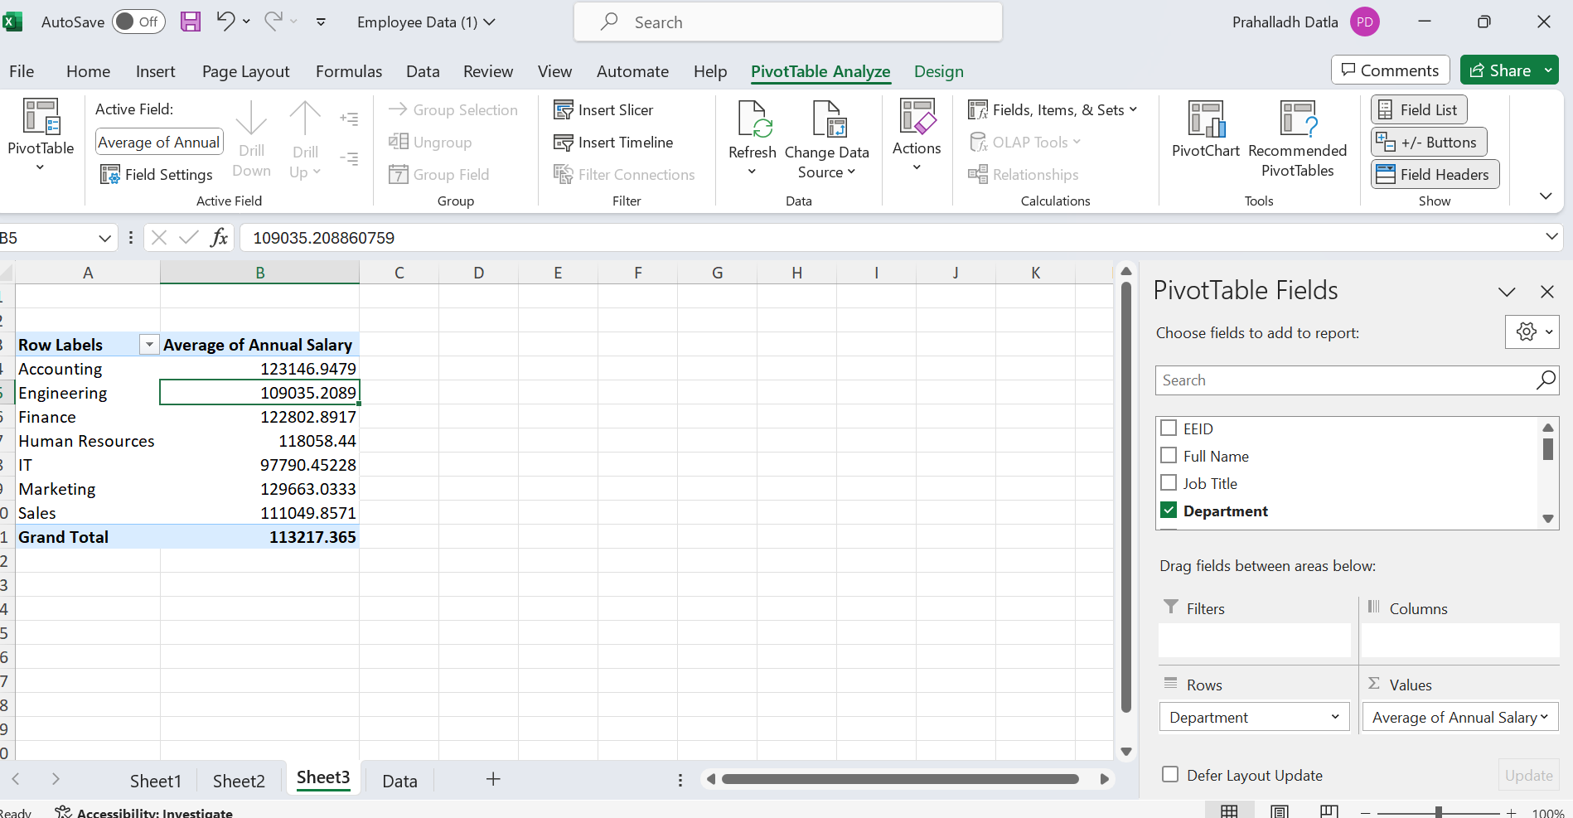
Q3.Salary Signific Diff
I used a Pivot Table , Departments in Row and Average salary in Values. This way I got the average salaries of each department. Now from the data, We can conclude that Accounting, Engineering,Finance,Marketing,Sales ,HR avg salaries are more than 1 lakh. IT Department salaries are near to 1 lakh. So from this there is no significant avg salary difference.

Slide 4
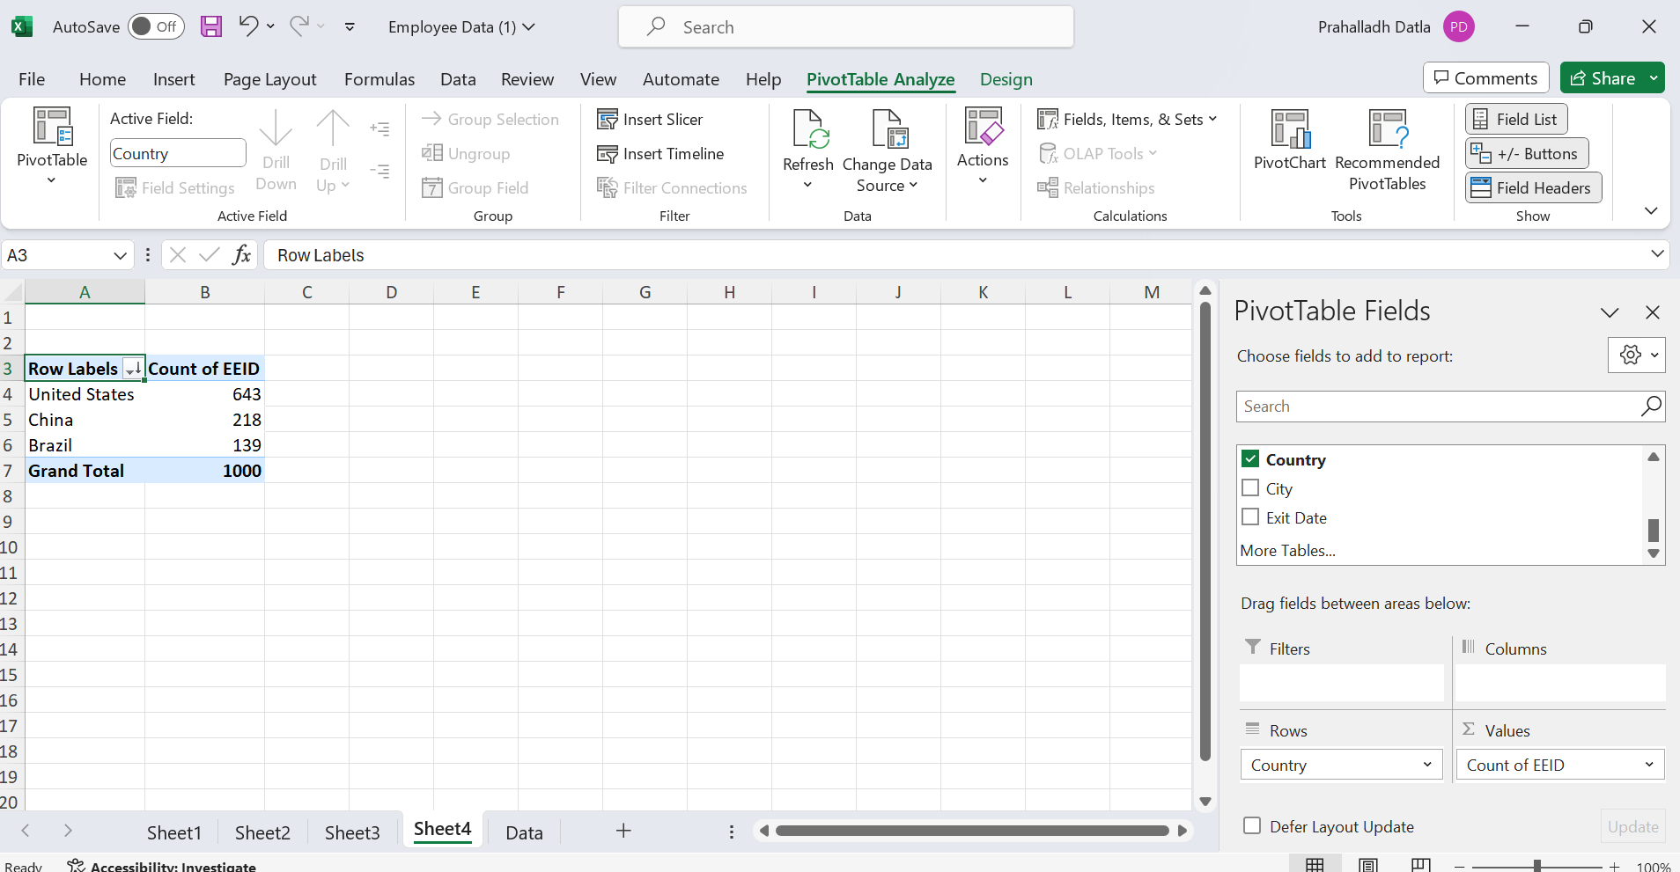
Q4. Highest No.of Emp
I used Pivot table
Country in rows and Count of EEID in Vlaues.
The data set has employees from three countries.
US,China and Brazil.
Among them United States has more no.of employees 643

Slide 5
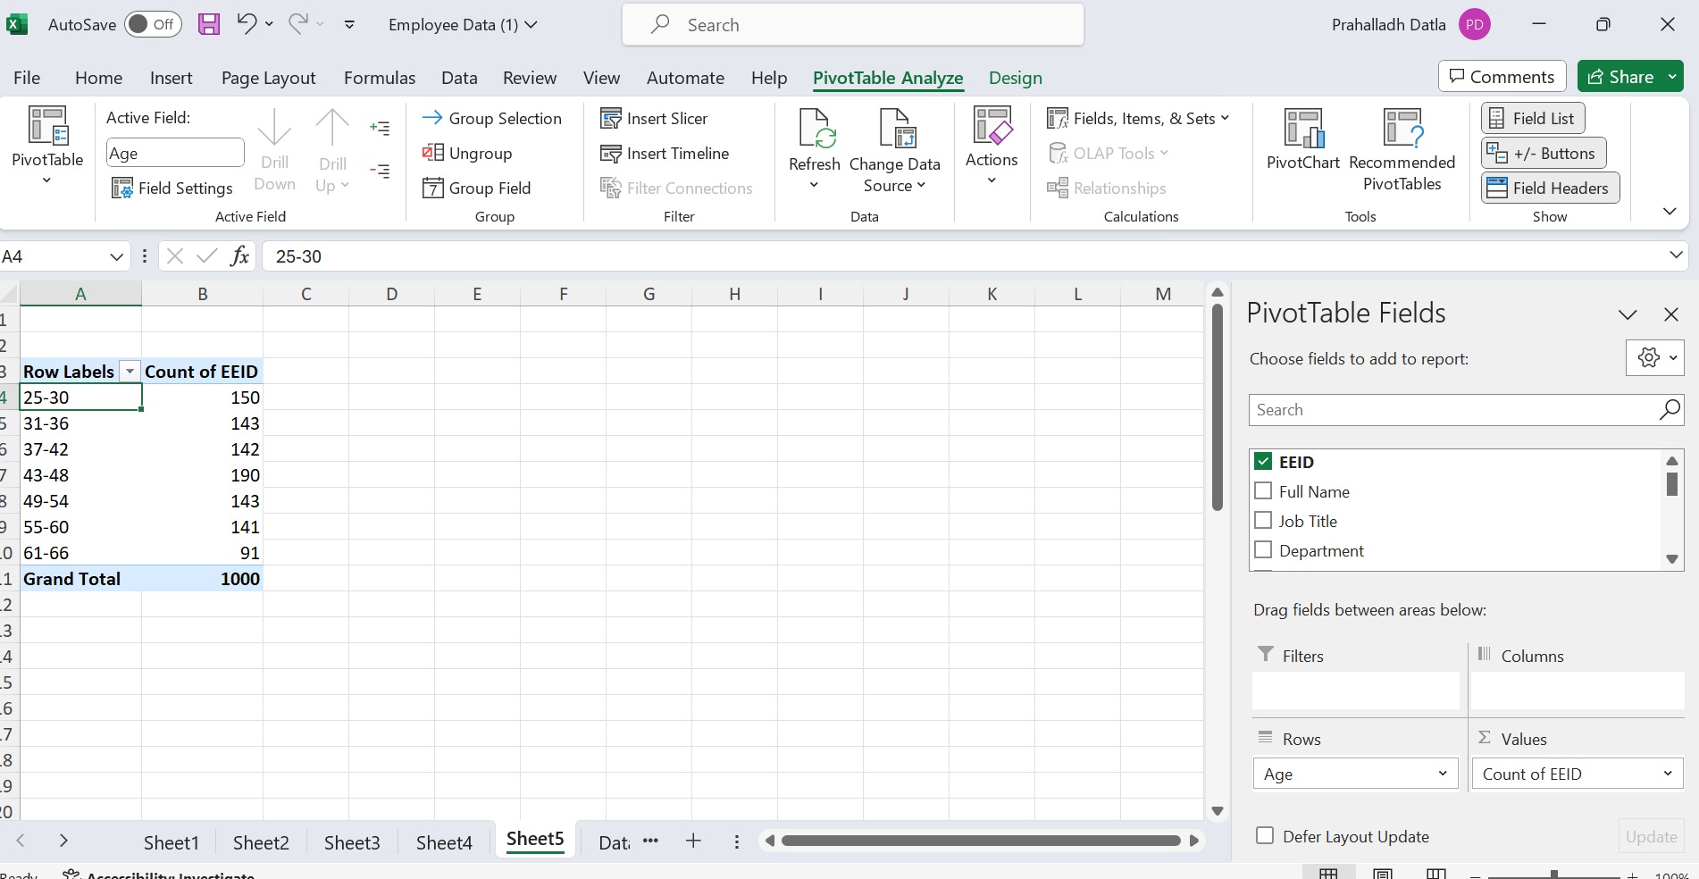
Q5.Most Common Age range
I have used Pivot Table
Age in Rows, Count of EEEID in Values
I have grouped the age into ranges using the group property by 6 years.
Then I got the number of employees in each age range.
From this we can conclude there are 190 ppl in the age group 43-48.
There is no most common age group. As from the data all the age groups have significant no of employees Except in the age group 61-66 which has less number of employees.

Slide 6
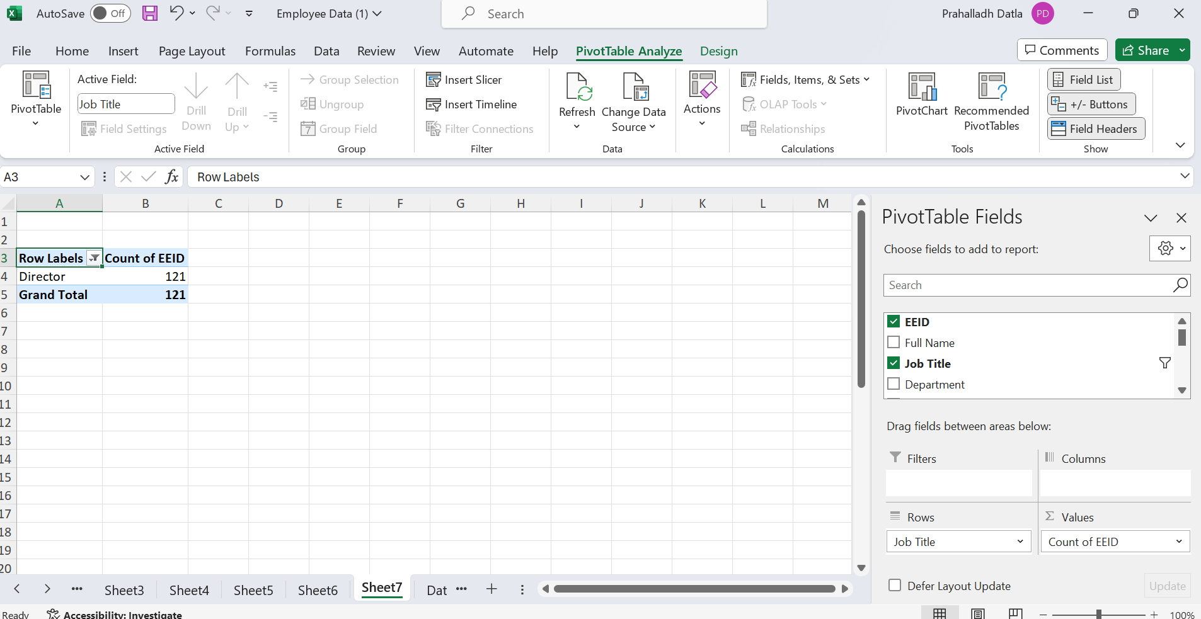
Q7.Frequent Job
Used Pivot Table.
Job title in Rows, Count of EEID in Values.
Then got all job titles with no of employees.
And then applied a value filter base, Top 1 Count OF EEID.
The most frequent job title in the dataset is Director with 121 entries.

Slide 7
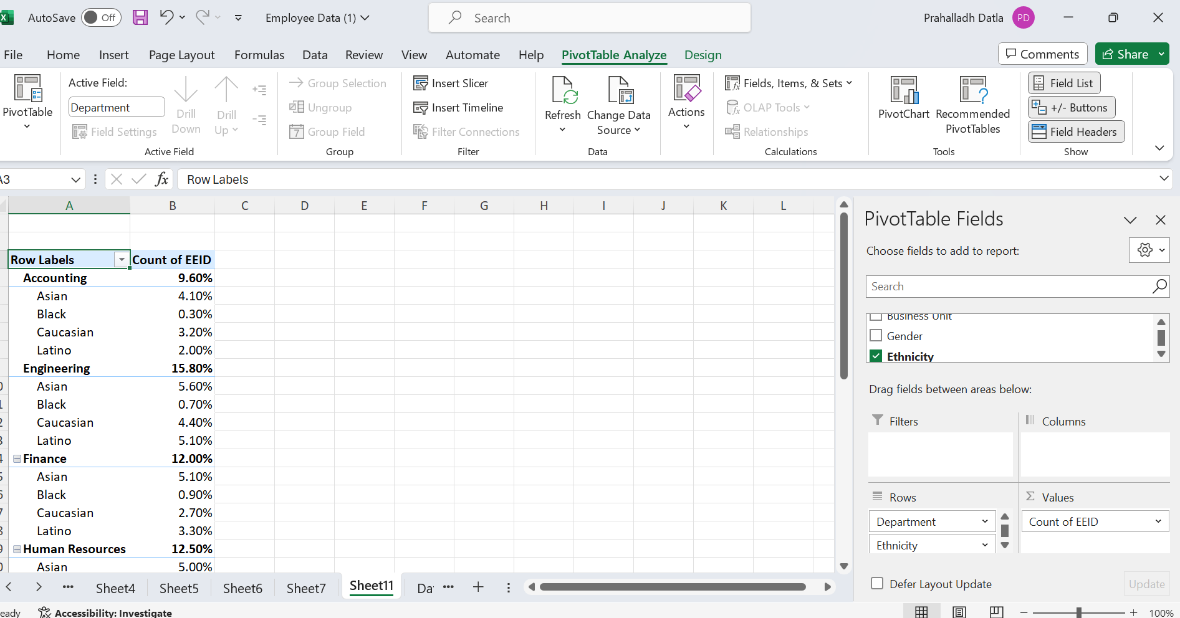
Q9.Are Certain Dept more diverse in Ethinicity
Used Pivot Table,
Department and Ethnicity in Rows and COUNT of EEID in Rows.
From the above data we can see that Black community are less in
All the departements compared to other departments.

Slide 8
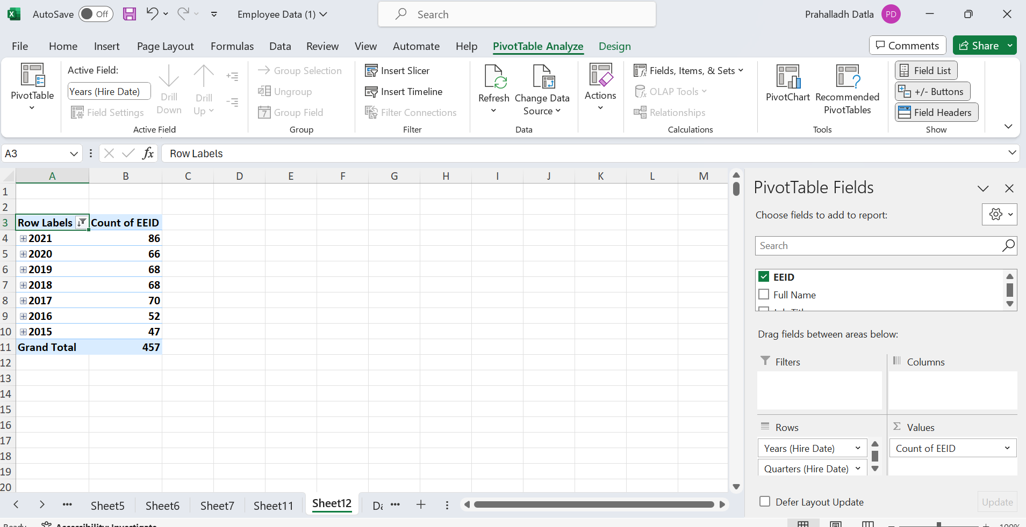
Q.10
Used Pivot Table,
Hire years in Rows, Count of EEID in Values.
Filterred the few years.
As we can see from the past few years from 2018 to 2020 it’s the same. Hiring increased in 2021.

